Slide 1
Primo PDF Creator
M Salter
Palm Creek computer club ~ march 2018

Slide 2
Download the program from www.download.com. Search for PDF creator.
Use this link (below) to directly access the file:
http://download.cnet.com/PrimoPDF/3000-18497_4-10264577.html
Install the program
It’s very simple. Just drag the file you wish to convert to a PDF over the icon.
Click on the Icon to make changes to PrimoPDF creator.

Slide 3
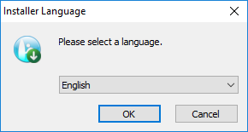
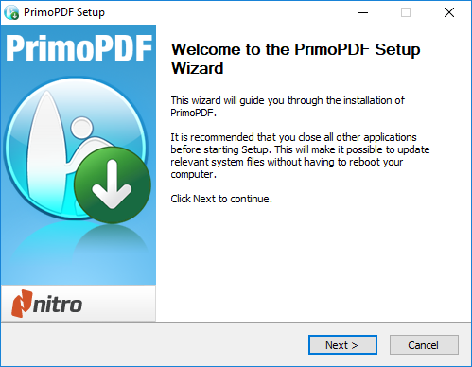

Slide 4
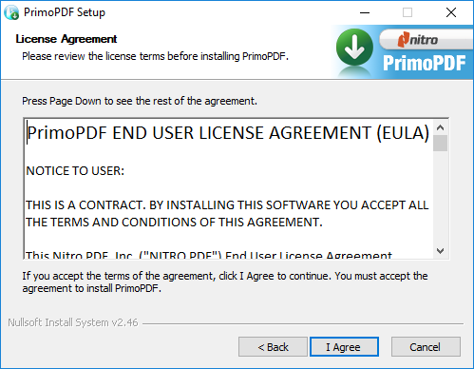
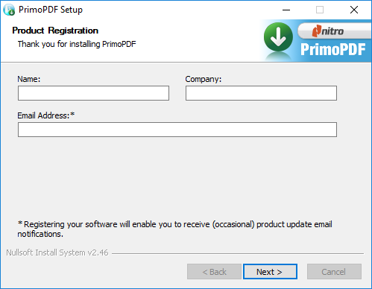

Slide 5
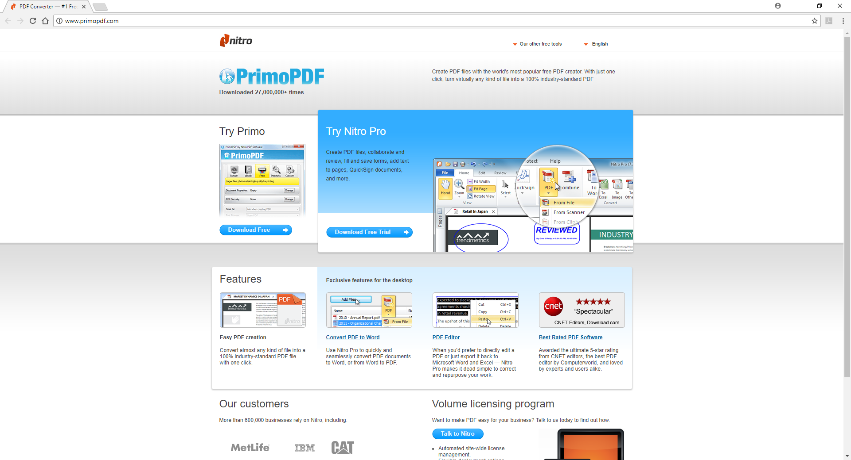
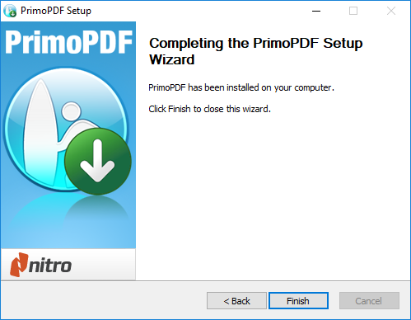

Slide 6
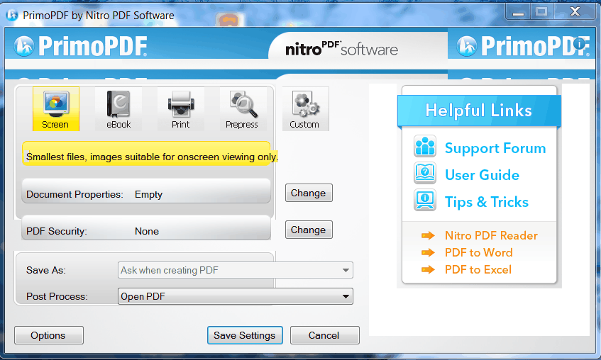

Slide 7
EDITORS' REVIEW
BY DOWNLOAD.COM STAFF / JUNE 23, 2014
PrimoPDF is a basic yet powerful application that revolutionizes PDF file creation. You can construct perfect PDF files using the straightforward drag-and-drop tool this application offers.
PROS
Valuable toolkit: PrimoPDF creates all types of files in standard PDF format faster than competitors, making it one of the best free applications we've tried. The custom settings give you the ability to lock files and determine design specifications, so files will be exactly as you want them.
Fast, precise operation: We converted various file formats with PrimoPDF, and our PDFs were created within seconds, no matter the size or type of file. No instance of lessened image quality was observed either.

Slide 8
EDITORS' REVIEW
BY DOWNLOAD.COM STAFF / JUNE 23, 2014
CONS
Dysfunctional support: PrimoPDF comes with an excellent user guide; however, many of the support links we clicked on were either broken or redirected us elsewhere. We only found the user guide and other assistance via Internet search.
Substandard design: We quickly noticed that nearly half of Primo's program window is consumed by advertisements for other software. This is understandable because it is a free application, but it complicates and detracts from the overall experience, nonetheless.

Slide 9
EDITORS' REVIEW
BY DOWNLOAD.COM STAFF / JUNE 23, 2014
BOTTOM LINE
PrimoPDF is an awesome, easy-to-use application for quickly creating PDF files. Including a larger, more robust GUI would make using PrimoPDF a tad easier, but there really isn't much that needs changing with this application. We highly suggest you use Primo if you need to create a PDF file; it's fast, reliable, and uncomplicated.

