Slide 1
Networks – Safety Concerns
Palm Creek Computer Club
Revisited ~ March 2018

Slide 2
Networks
Finding a Network
Connecting to a Network
Secure Network Password
Selecting a Network “Location”

Slide 3
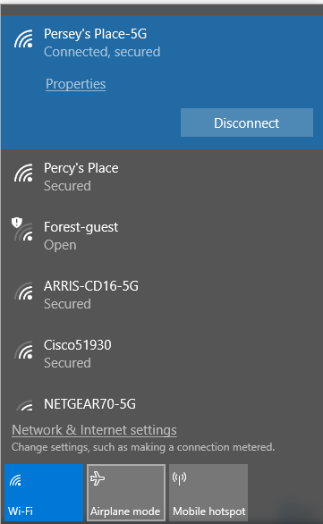
Finding a Network
Network is available
This one might not be secure!

Slide 4
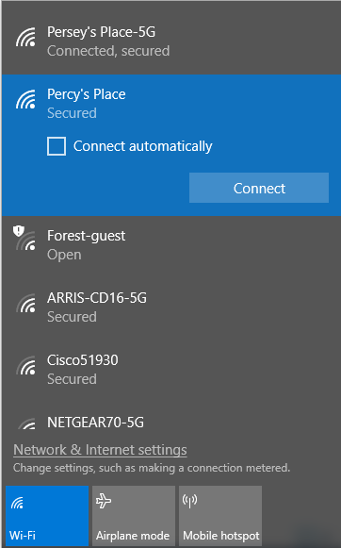
Connecting to a Network
Choose the strongest (if available)
Connect automatically if this is your Primary Network

Slide 5
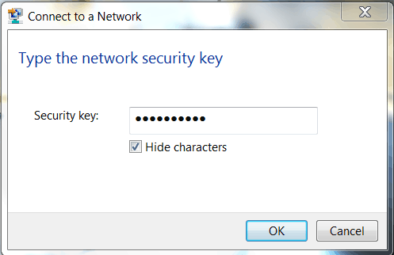
A Secure Network requires a Password

Slide 6
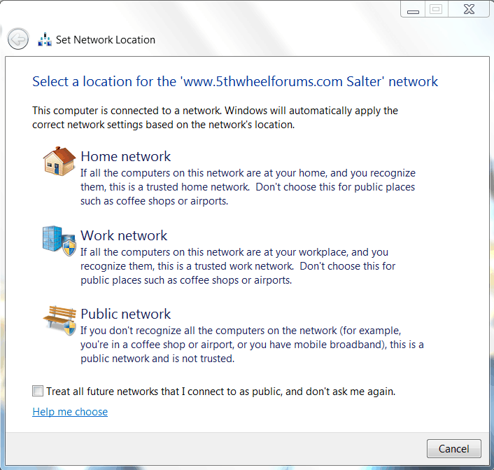
Select the Network Location

Slide 7
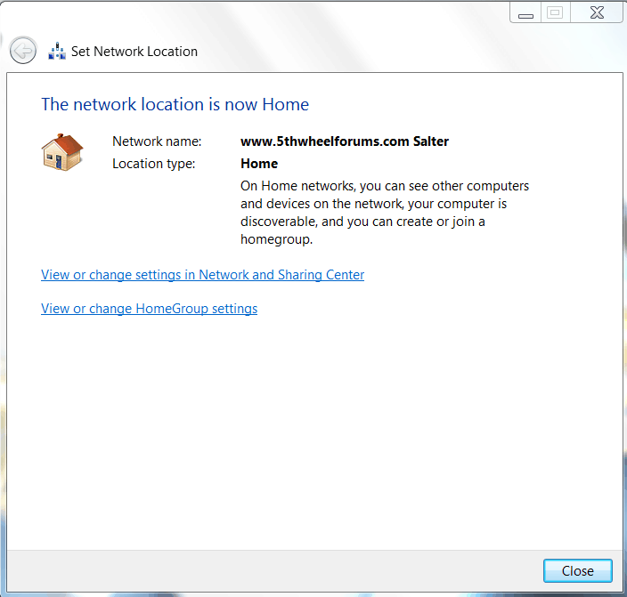
Confirmation of Network Choice

Slide 8
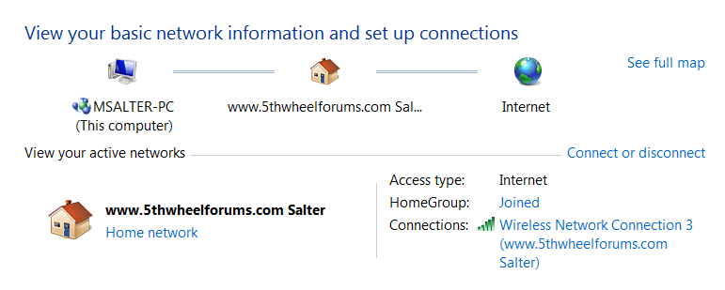
Network Map

Slide 9
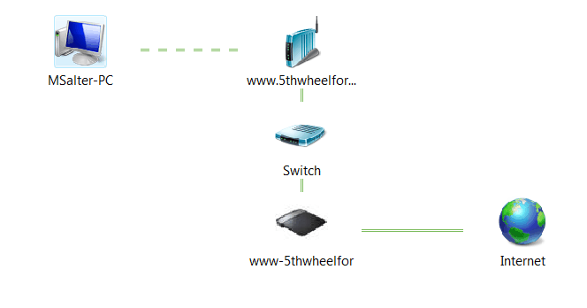
Network Map - expanded

