Slide 1
BCC
M Salter
Palm Creek Computer Club - March 2018

Slide 2
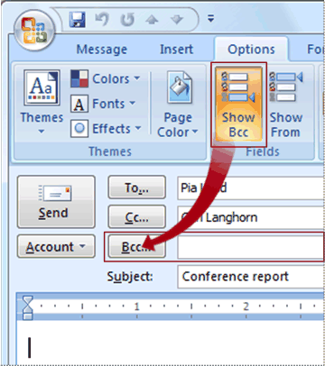
Bcc is an abbreviation for blind carbon copy. If you add a recipient's name to the Bcc box in an e-mail message, a copy of the message is sent to the recipient, but the recipient's name is not visible to the other recipients of the message. If the Bcc box is not visible when you create a new message, you can add it
In a new message, on the Message Options tab, in the Fields group, click Show Bcc.

Slide 3
Best practices for using Bcc
Pave the way Before you add an intended recipient's name to the Bcc box in a message, make sure that the recipient is expecting your message. That person may need to take steps to establish you as a safe sender (or a safe recipient, if your name will be in the To box of the message).
Why is this necessary? Using Bcc is a favorite technique of spammers. Therefore, a lot of junk e-mail filters flag messages that use the Bcc box as junk. So if your intended recipient has not added your name to the Safe Senders List in Microsoft Outlook, your message may go straight to the Junk E-mail folder or its equivalent.

Slide 4
Best practices for using Bcc (cont’d)
Think before you include a distribution list in the Bcc box People who use rules to sort their e-mail into folders will be inconvenienced if you list the name of the distribution list in the Bcc box. Because their rules depend on the name of the distribution list being in the To box or Cc box, your message will not be sorted according to their rules.

Slide 5
Best practices for using Bcc (cont’d)
Know your limits Many e-mail service providers set limits for the number of names that can be included in the To, Cc, and Bcc boxes in a message. For example, your e-mail service provider may limit each message to a maximum of 100 e-mail addresses. If these addresses are distributed among the To, Cc, and Bcc boxes, remember that the names in the Bcc box will count toward your total limit. Ask your e-mail service provider about the policies for your account.

Slide 6
Ideas for using Bcc
Keep the recipient list private Bcc can help you to be respectful of others' privacy by keeping them in the loop without disclosing their identities. For example, if you send a job announcement to multiple people, you may want to use Bcc to keep the identities of the potential job seekers private.

Slide 7
Ideas for using Bcc (cont’d)
Help curb a conversation that has gone wild Here is one situation in which using Bcc for a distribution list or a large number of names can be helpful.
Suppose you send a message with a large number of people listed in the To box. The discussion starts to get lively, and everyone wants to give an opinion. The number of messages increases drastically because many recipients reply with the sentiment "please stop replying all to this message.”

Slide 8
Ideas for using Bcc (cont’d)
The problem is that when they do this, they click Reply to All. One way to curb the use of the Reply to All option is to respond and put the name of the distribution list in the Bcc box. For example, you can click Reply, put only your name in the To box, move the distribution list to the Bcc box, and write a message similar to the following:
"I appreciate peoples' thoughts on this issue. If you have further comments, please respond to me directly. (I have put this distribution list in the Bcc box to cut down on the reply-to-all messages.)

